Slide 1
NATURAL LANGUAGE PROCESSING
HOMEWORK
By Ravinthiran Partheepan

Slide 2
Abstract
Text summarization is a process of extracting or collecting important information from original text and presents that information in the form of summary. Text summarization has become the necessity of many applications for example search engine, business analysis, market review. Summarization helps to gain required information in less time. This innovation is an attempt to summarize and present the view of text summarization from every aspect from its beginning till date.

Slide 3
Approaches
The two major approaches i.e., extractive and abstractive summarization is discussed in detail.
The technique deployed for summarization ranges from structured to linguistic.
Summarization
Abstractive
Extractive

Slide 4
Abstractive and Extractive Summarization
Extractive summarization is basically creating a summary based on strictly what you get in the text. It can be compared to copying down the main points of a text without any modification to those points and rearranging the order of that points and the grammar to make more sense out of the summary.
Abstractive summarization techniques tend to mimic the process of ‘paraphrasing’ from a text than just simply summarizing it. Texts summarized using this technique looks more human-like and produce more condensed summaries. These techniques are much harder to implement than extractive summarization techniques in general.

Slide 5
Text summarization, when is it better to use abstractive or extractive analysis algorithms?
Abstractive summarisation is definitely better, but it's much more difficult to implement compared to extractive summarisation.
Regarding "when is it better to use abstractive or extractive analysis algorithms?" , depends how you intend to use the summary .
If you are concerned about copyright/ownership/modification of original content, then abstractive summary is definitely better curation of the content.
Facebook recently released abstractive summary implementation using Neural Attention Model.

Slide 6
Page Rank & Text Rank Algorithm
Page Rank - PageRank is used primarily for ranking web pages in online search results.
Text rank - In place of web pages, we use sentences.
Similarity between any two sentences is used as an equivalent to the web page transition probability
The similarity scores are stored in a square matrix, similar to the matrix M used for PageRank.
TextRank is an extractive and unsupervised text summarization technique.

Slide 7
Analytical methods at glance :-
Extractive Methods
Selecting set of sentences from the source text, then arranging them to form a summary
Abstractive Methods
Using the natural language generation techniques to write novel sentences
Methods
Methods
Luhn
LexRank
Sequence to Sequence
Pointer Generation
Network
TextRank
LSA

Slide 8
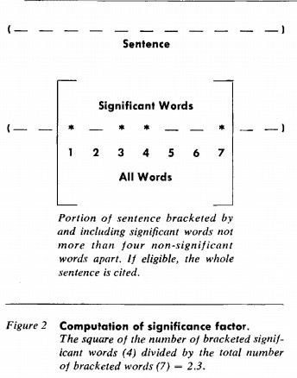
Extractive – Luhn Method
What is Luhn method?
Frequency of the word in the text
Pros
Can highlight the important topics of the document
=
Significance factor
Relative position of the word in the sentence
Bracketing
Limitations
Very few features of the text taken into consideration, might not give accurate results
More weight to sentences at the beginning of the document or a paragraph
3

Slide 9
Extractive – TextRank Method
What is TextRank method?
Pros
It takes into consideration both the number of links and their weightage
Similar to Google’s famous PageRank
method(graph based)
Data will be preprocessed to remove the irrelevant data
Words will be vectorised and a ‘Cosine Similarity Score’ is calculated
‘Similarity matrix’ will be created –
similarity b/w any two sentences
Limitations
Can only be used for single document summarization
6

Slide 10
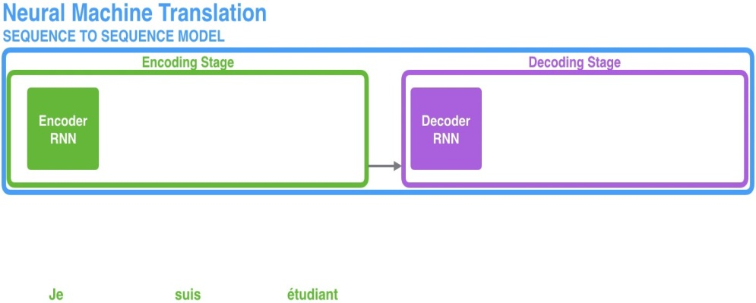
Abstractive – Sequence to Sequence Method
Pros
Work in abstractive sense, performs similar to a human.
Based on machine learning
optimization accuracy can be improved.
Same network can trained for any other language or for translation
What is Sequence to Sequence method?
Text is fed to encoder units and the intermediate form(hidden state) is fed to decoder.
Stacked RNN/LSTM units are used for encoding and decoding
Limitations
Training time increases as size of input data increases(number of encoders)
Summary is generated by lookup from vocabulary (limited abstraction)
No coverage of what has already been decoded

Slide 11


Benchmark metrics
Major 3 metrics were considered: ROUGE, METEOR and BLUE – String matching metrics
Brief:
ROUGE-N measures the overlap of N-grams between the system and reference summary
ROUGE-L is based on longest common subsequences. Takes into account sentence level similarity.
METEOR score matches the unigrams between the system and reference summary with explicit care with respect to sentence ordering
Summarization method | Rogue Score(ROUGE-L) | METEOR Score
TextRank | 0.500 | -
LexRank | 0.469 | -
Seq2Seq | 31.2 | -
Pointer generator | 36.38 | 18.72

Slide 12



Use Case: Planning and Procurements Influenced by Trends:
Summarizing and tagging the Current trends for any business can provide valuable insights and make the planning and procurement process better
Examples:
Fashion articles can augment the Design Success Probability project (illustrated below)
Latest Auto news can support Novelis R&D and customer negotiations
Shutdowns in factories which supply raw mater can help in taking pre-emptive measures and protect from increased raw material prices
Text Summarizer
The articles are passed through the summarizer that is trained to pick up specific design elements
Tagging
The various design elements are tagged according on clothing category
Fashion Articles
News and magazines articles showing latest fashion trends and top selling designs

Slide 13
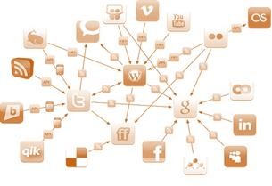

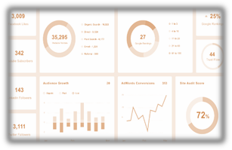
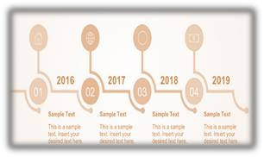
Text Summarizer Business applications:-
Summarize Noisy, Unstructured, Ungrammatical, Huge Volume of Data for Pantaloons & MFL
Sentence compression from news articles & stock market reports for Aditya Birla Capital
Storylines of events : Identify and summarize events of Idea that leads to the event of interest
Summarizing Internal sales report at various levels for UltraTech cement

Slide 14



TextSummarizer – Function applications:-
Legal and employee document screening and summarization for HR Dept
Summarization of bill, contract, order details using vendor documents for ABMCPL
Summarizing news articles for central economic cell consisting regulation and economic conditions

Slide 15
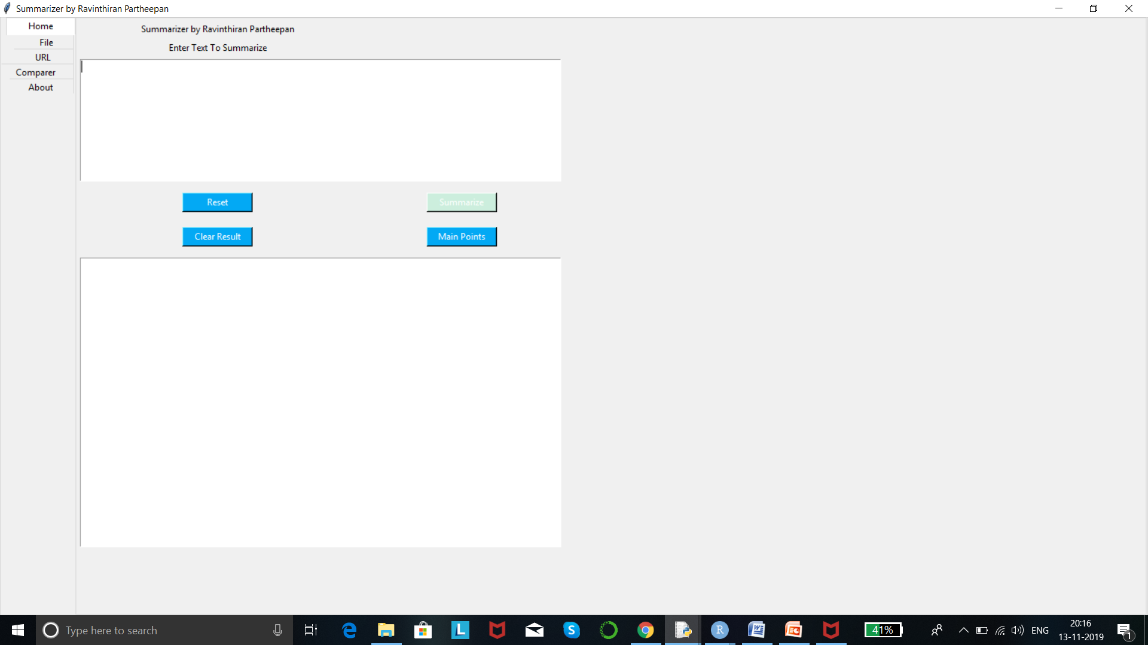
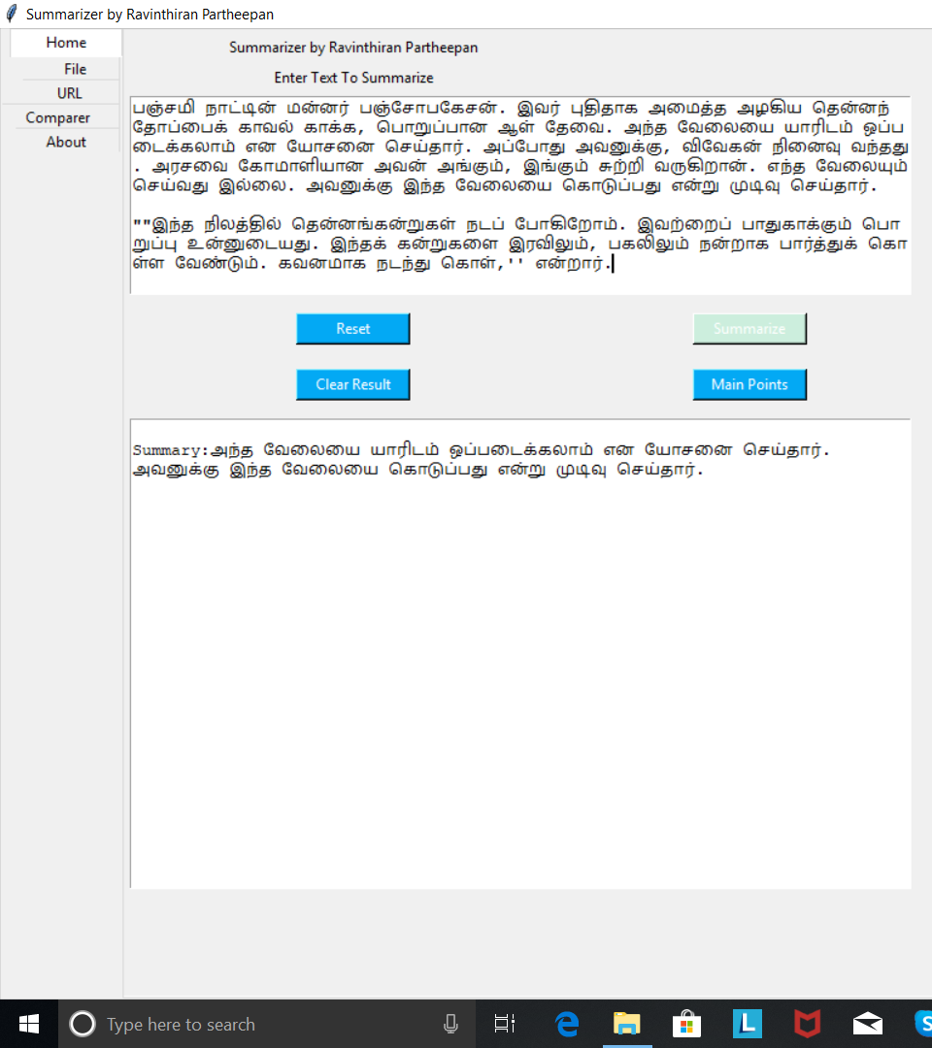
Output

Slide 16
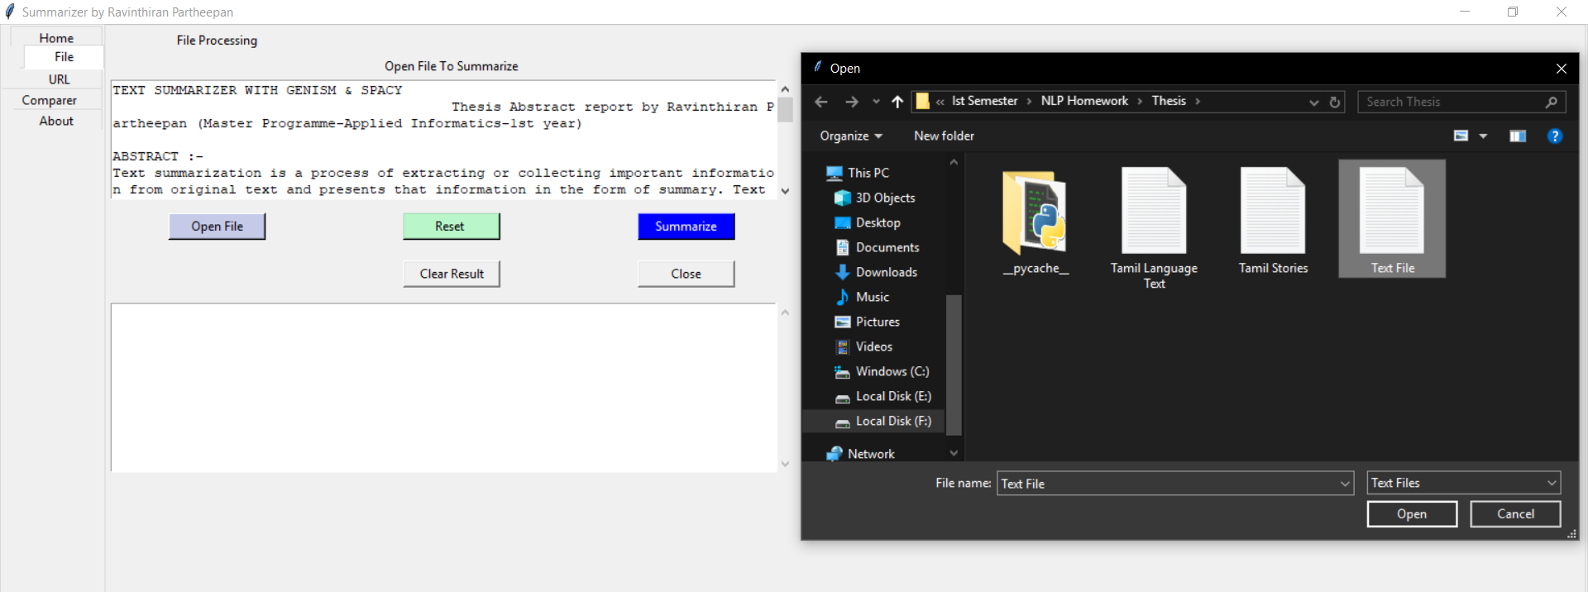
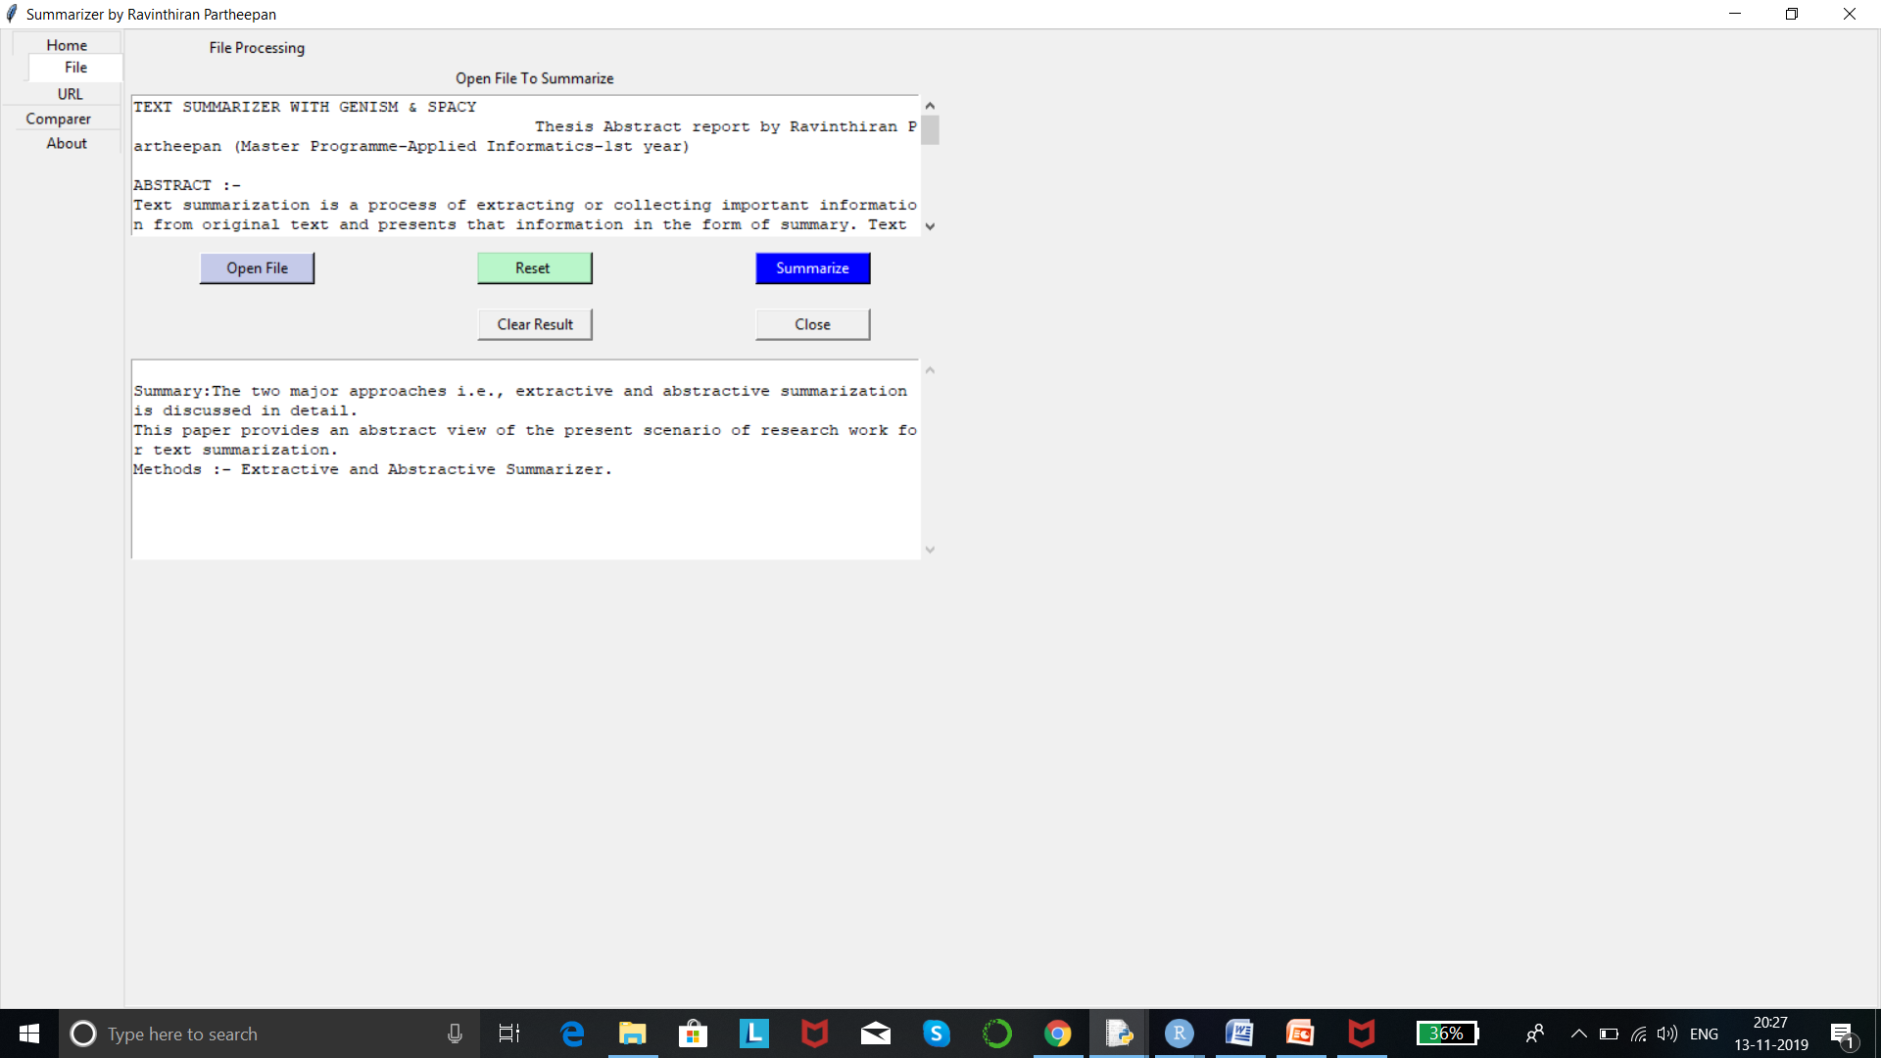
Output – File Processing

Slide 17
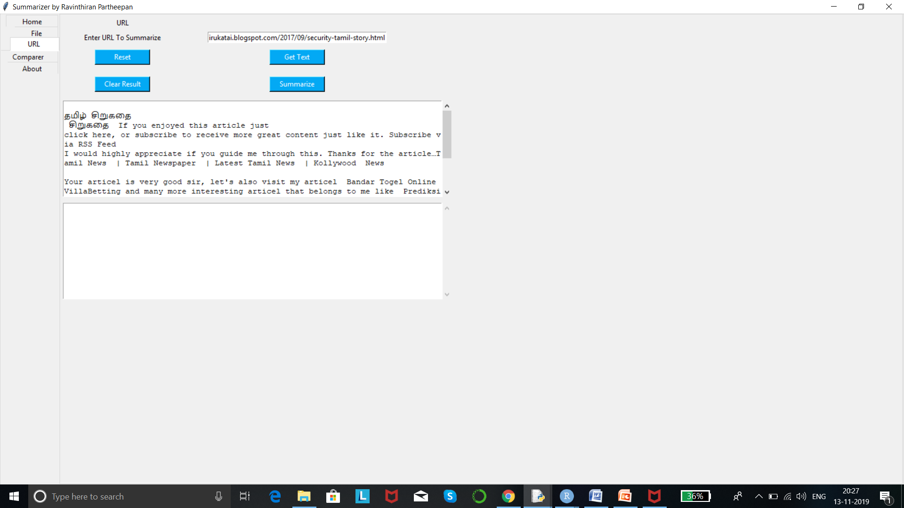
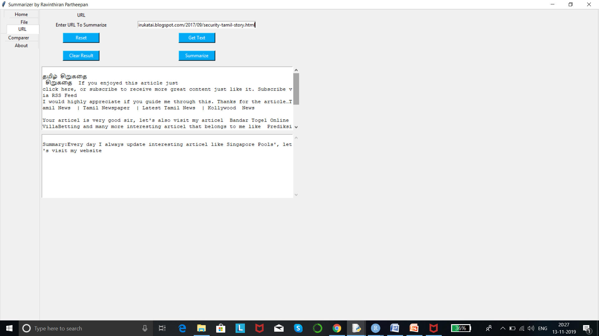
Output – URL To Summarize

Slide 18
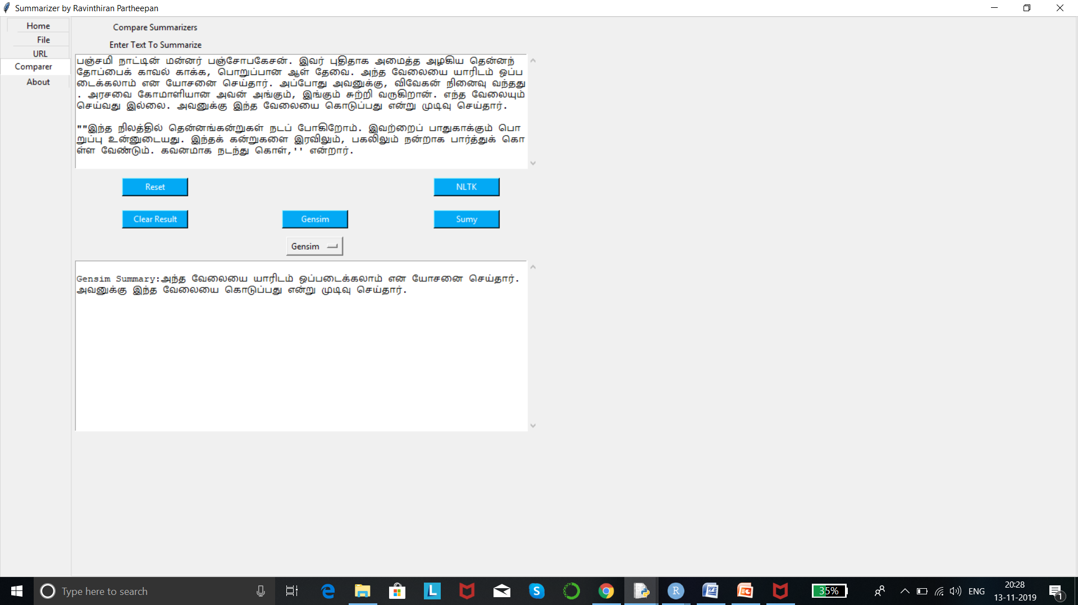
Output – Gensim

Slide 19
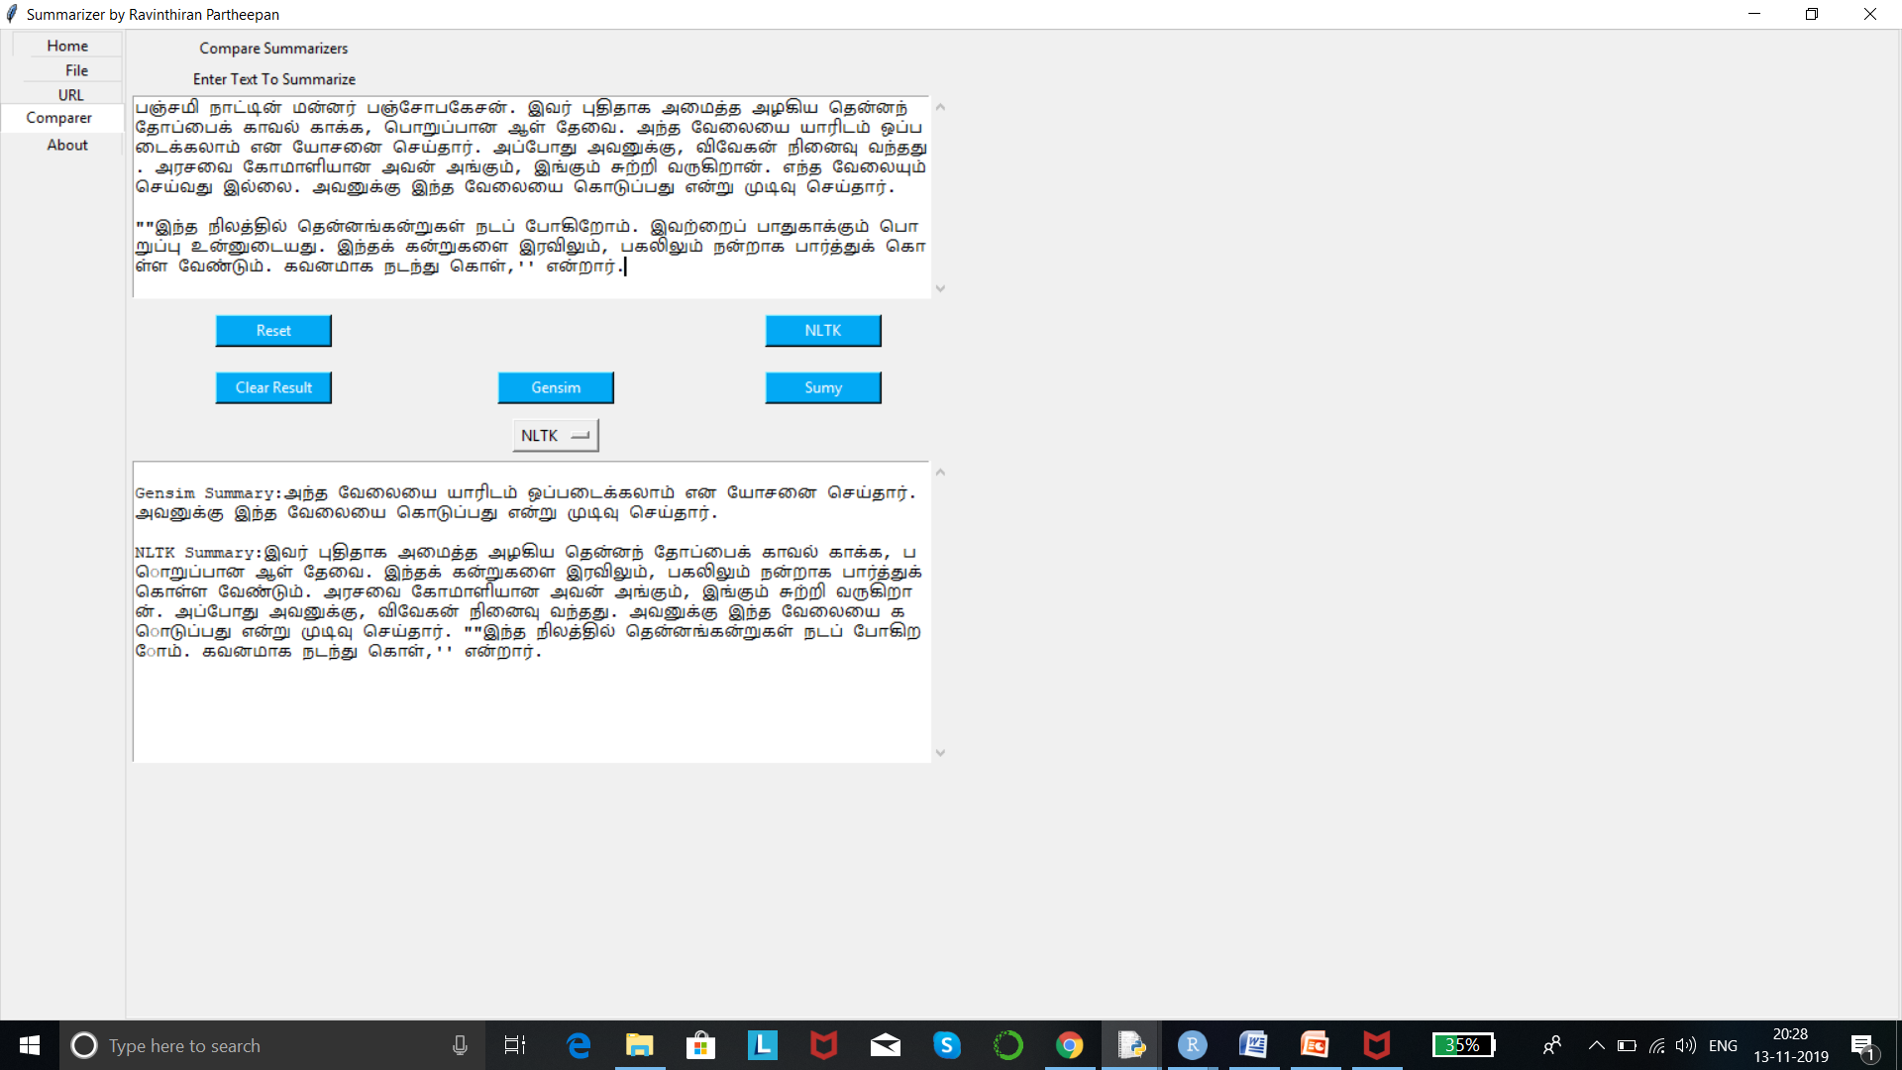
Output – NLTK

Slide 20
Thank You!

